Slide 1
FIELD DATA MONITORING SYSTEM
INDUSTRIAL INTERNSHIP REVIEW
UTKARSH SHARMA
16BCE0226
COMPANY: Oil and Natural Gas Corporation
LOCATION: Institute of Reservoir Studies, Ahmedabad
DURATION: 14th of May,2018 – 15th of June, 2018

Slide 2
Contents:
About ONGC
Flow Chart
Languages and Libraries used
Tasks accomplished during the training
Conclusion

Slide 3
About ONGC
Oil and Natural Gas Corporation Limited (ONGC) is an Indian multinational oil and gas company. It is a Public Sector Undertaking (PSU) of the Government of India, under the administrative control of the Ministry of the Petroleum And Natural gas. It is India’s largest oil and gas exploration and production company. It produces around 69% of India’s crude oil (equivalent to around 30% of the country’s total demand) and around 62% of its natural gas. ONGC’s operations include conventional exploration and production, refining and progressive development of alternate energy sources like coal-bed methane and shale gas.
IRS (Institute of Reservoir studies) is the department which is involved in Research in order to maximize oil recovery & optimize exploitation & formulation of reservoir development schemes, reservoir management, Eor studies, pilot schemes, Pvt Analysis, well productivity improvement, reservoir geophysical studies, and consultancy services etc.

Slide 4
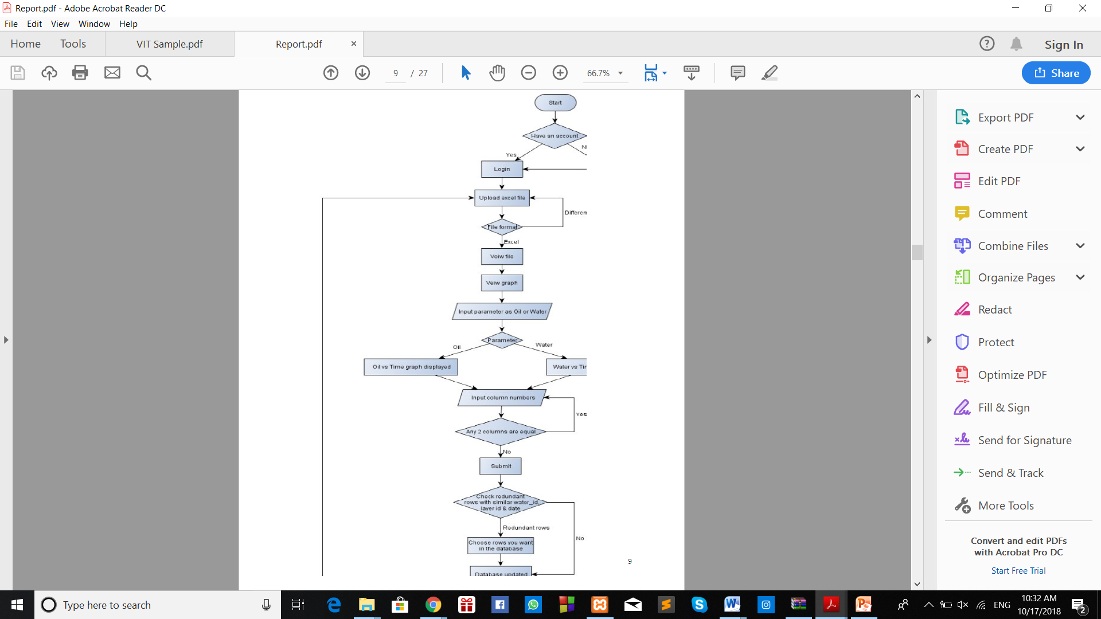
Flowchart

Slide 5
Languages and Libraries:
1) PHP
PHP stands for hypertext pre-processor. PHP is a server-side scripting language designed for web development but also used as a general-purpose programming language.
2) Javascript
JavaScript is a client-side scripting language, which means the source code is processed by the client's web browser rather than on the web server. This means JavaScript functions can run after a webpage has loaded without communicating with the server.

Slide 6
3) Bootstrap
Bootstrap is a free and open-source front-end web framework for designing websites and web applications. It contains HTML- and CSS-based design templates for typography, forms, buttons, navigation and other interface components, as well as optional JavaScript extensions.
4) jQuery
jQuery is a concise and fast JavaScript library that can be used to simplify event handling, HTML document traversing, Ajax interactions and animation for speedy website development. jQuery simplifies the HTML's client-side scripting, thus simplifying Web 2.0 applications development.

Slide 7
5) Ajax
Ajax is a client-side script that communicates to and from a server/database without the need for a postback or a complete page refresh. It is the method of exchanging data with a server, and updating parts of a web page – without reloading the entire page.
6) Handsontable
Handsontable is a spreadsheet component written in JavaScript and not constrained by any external framework. It can be easily modified or extended with custom plugins. Handsontable also binds to any source using the JSON format and handles large amounts of data. One can easily do all CRUD operations and provide end-users with an Excel-like experience.
Handsontable introduces a new approach to building spreadsheets for web projects. Typically, libraries like this gives all the features in one, pre-built package. This is not very effective as spreadsheets are usually very complex and heavy tools, so even though you just need just a single feature, you end up with overhead code.

Slide 8
7) SVG
Scalable Vector Graphics (SVG) is an XML-based vector image format for twodimensionalgraphics with support for interactivity and animation. The SVG specification is an open standard developed by the World Wide Web Consortium (W3C) since 1999. SVG images and their behaviors are defined in XML text files. This means that they can be searched, indexed, scripted, and compressed. As XML files, SVG images can be created and edited with any text editor, as well as with drawing software.
8) D3.js and NVD3
D3.js is a JavaScript library for manipulating documents based on data. D3 helps us bring data to life using HTML, SVG, and CSS. D3 allows us to bind arbitrary data to a Document Object Model (DOM), and then apply data-driven transformations to the document.
NVD3 is basically an extension to d3.js and is an attempt to build re-usable charts and chart components for d3.js without taking away the power that d3.js gives.

Slide 9
TASKS ACCOMPLISHED DURING THE TRAINING
Creating an account and signing in.
Viewing and modifying data from the excel sheet.
Displaying data in the form of line graphs.
Checking for redundancy and dumping data into database.

Slide 10
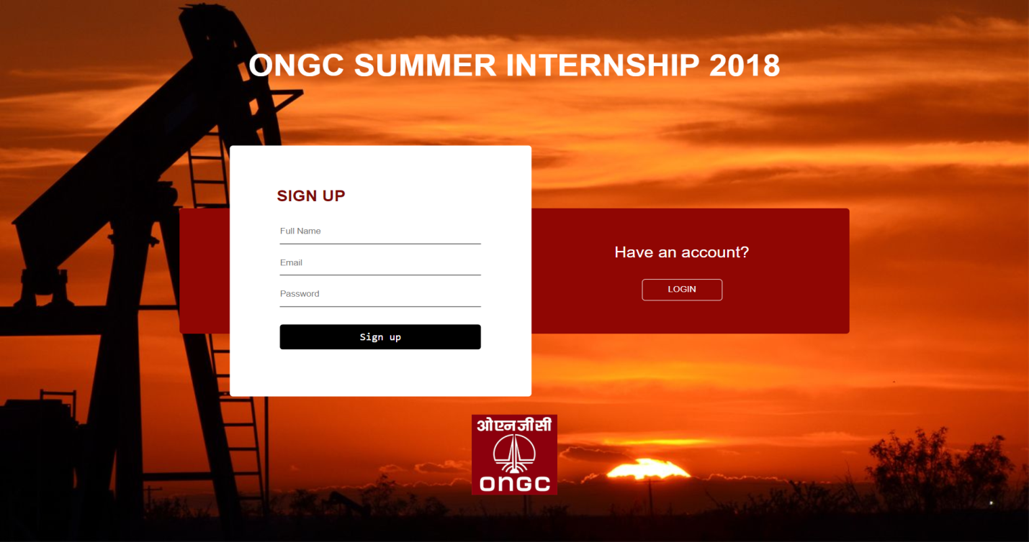
Creating an account
This module deals with creating an account for the user by registering using a unique combination of email id and password. The user can later log in into his/her account by using the same set of email id and password to access the web application for later stages.

Slide 11
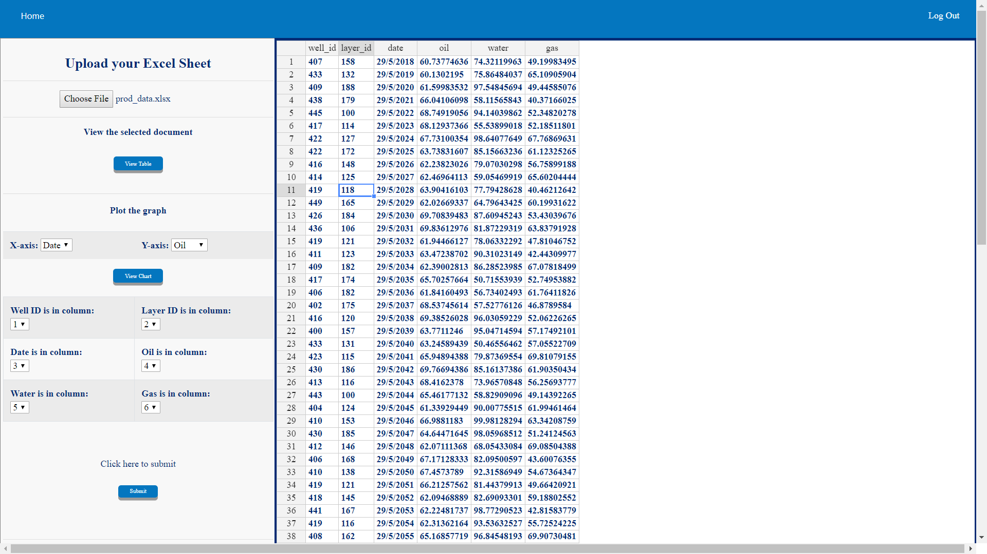
Viewing and modifying data from the excel sheet.
This module basically deals with reading the excel sheet chosen by the user and displaying its contents as such on the webpage in the form of a spreadsheet like view.
The table displayed on the webpage offers a real-time spreadsheet like experience to the user and the user can actually change/alter/delete the contents of the cells individually by selecting the desired cell.

Slide 12
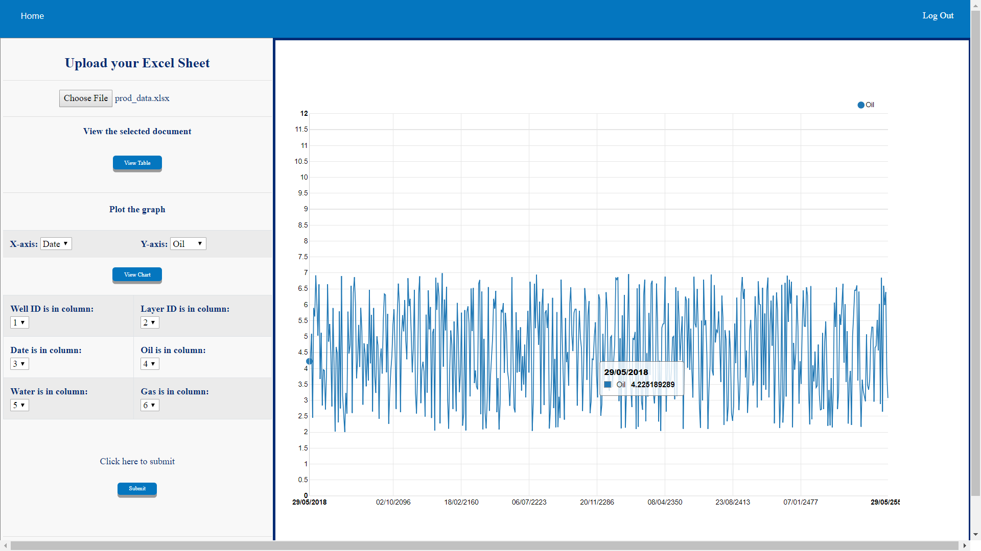
DISPLAYING THE DATA IN THE FORM OF LINE GRAPHS
Under this module, the values of oil production and water can be analyzed using the line graph corresponding to different dates. The user can choose to plot oil v/s date or water v/s date depending on the requirement. The values can further be analyzed for further manipulation and statistical analysis.

Slide 13
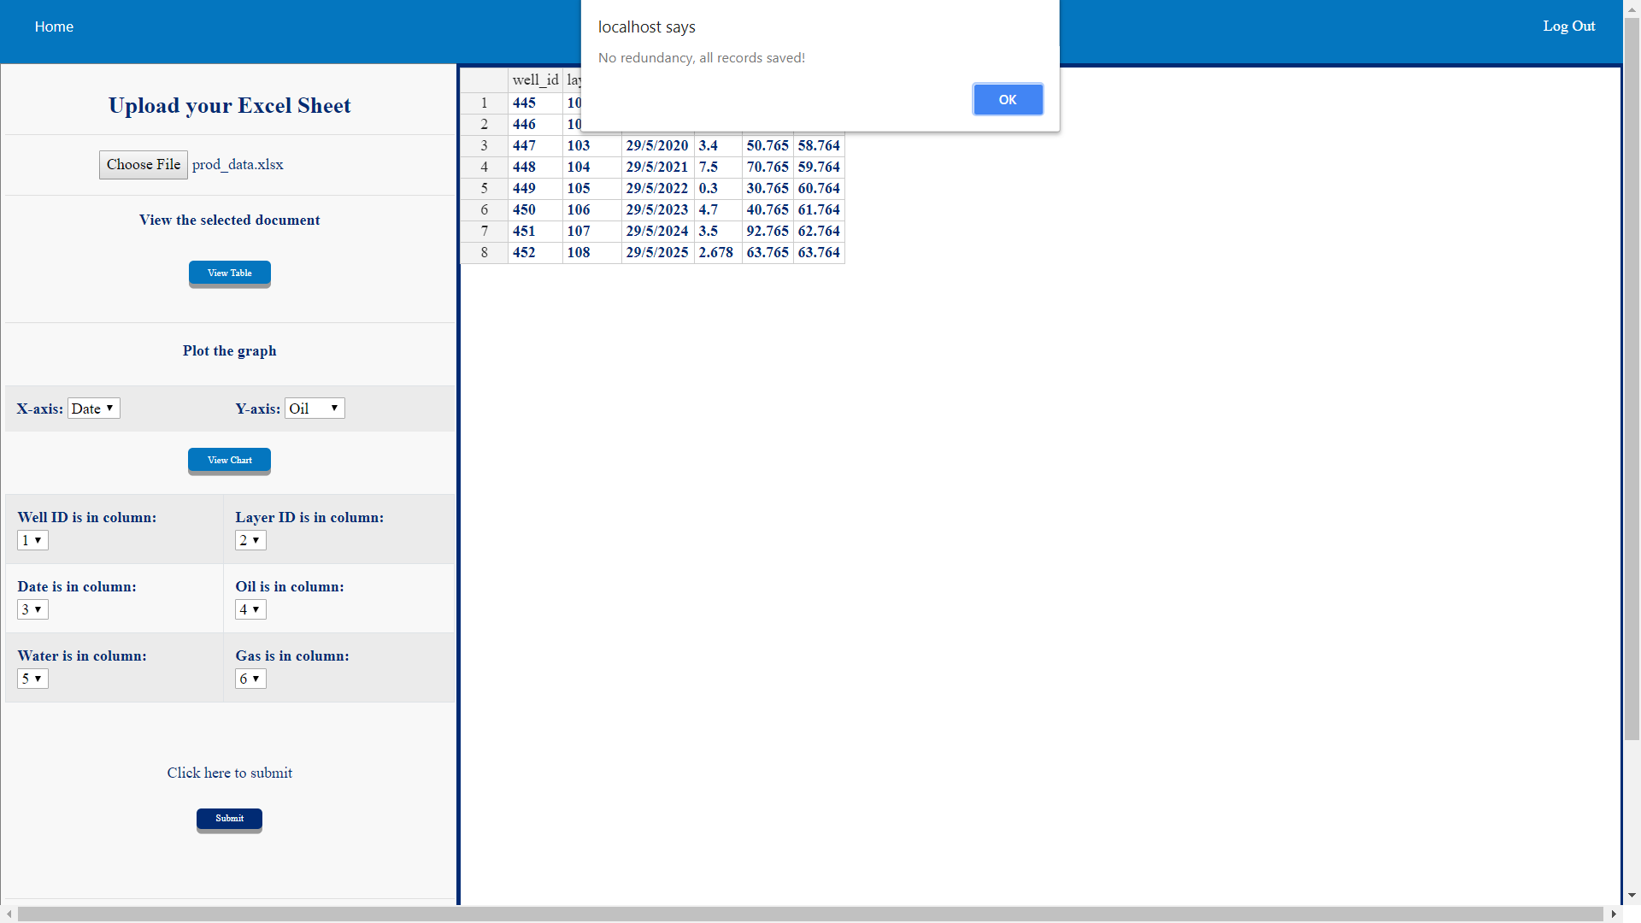
Redundancy Check
This module deals with choosing the corresponding column numbers of “Well ID”, “Layer id”, “Date”, “Oil”, “Water” and “Gas” so that the values from the corresponding columns can be fetched. They are then checked for redundancy and after necessary manipulation, the values are later dumped into the database.

Slide 14
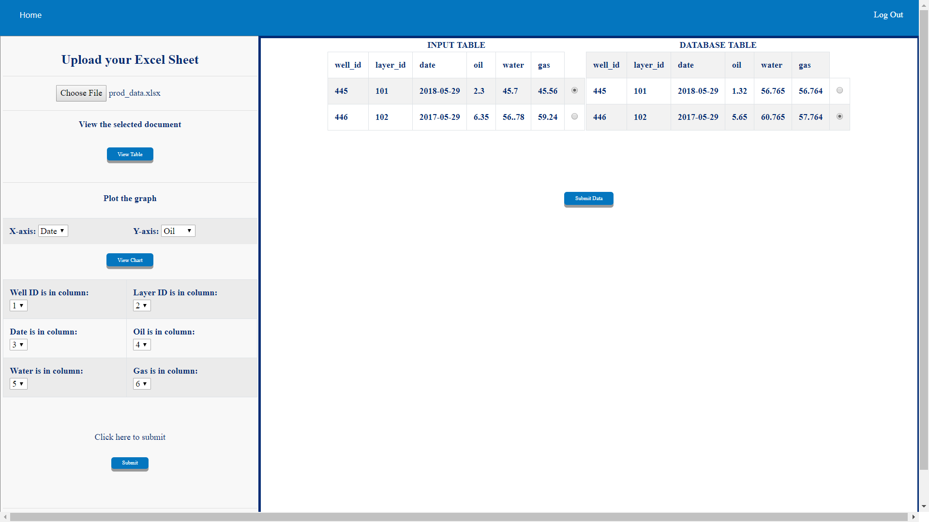
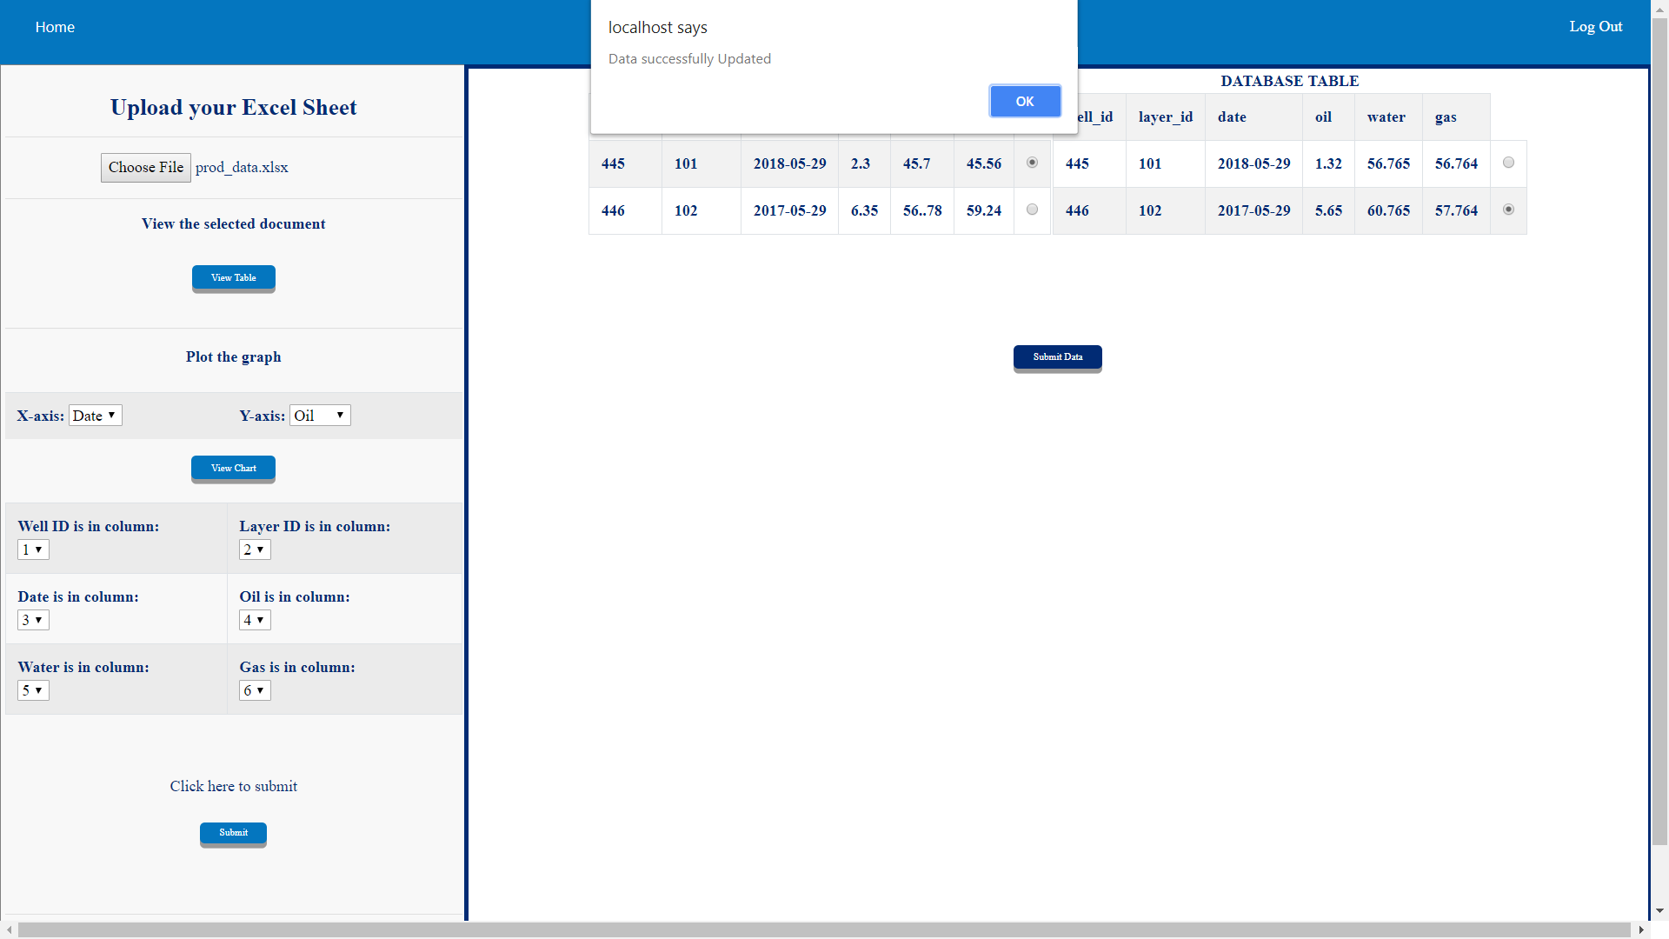

Slide 15
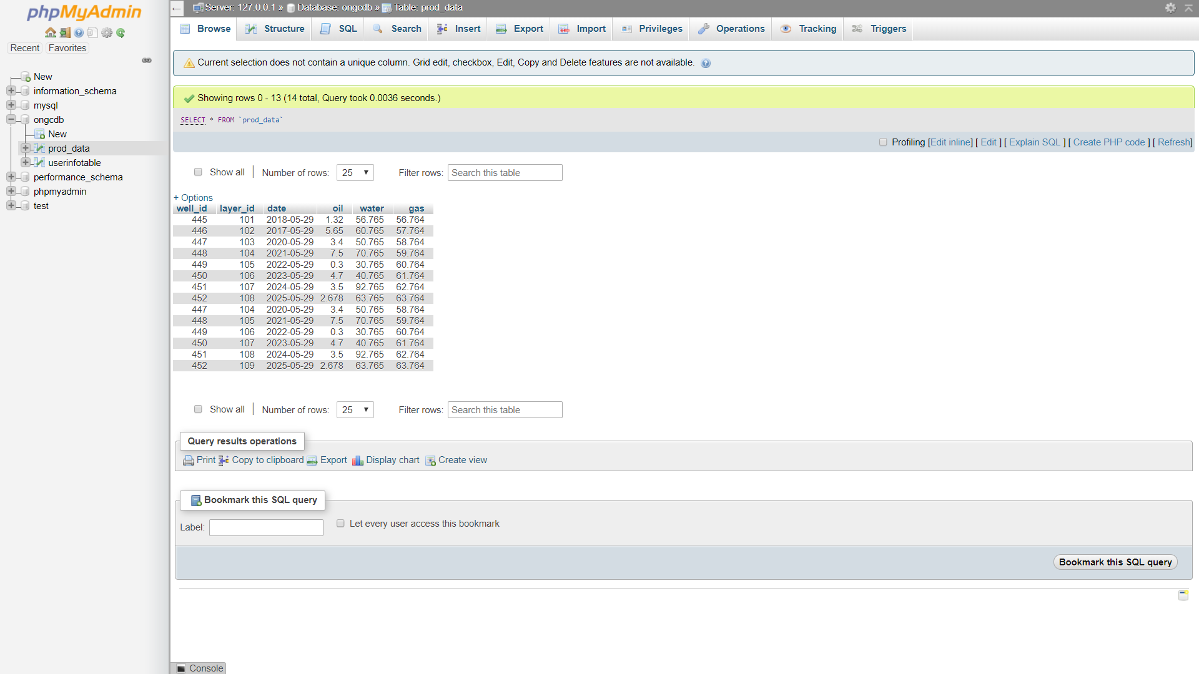
The updated database can be viewed thereafter

Slide 16
Conclusion
As an undergraduate of the VIT University, I would like to say this internship gave me the opportunity to experience the workings of a big organization like ONGC. It taught me how to coordinate with my co-interns and build up a team spirit and that how important it is to work as a whole and not as individuals when you're working on a project. I was lucky enough to get a mentor as helpful as Mr. Arpit Buddhiwant, who guided me at every step of the project.

Slide 17
THANK YOU

